Slide 1
Intertraffic 2016 Sitraffic smartTL Connect
Afonso Sousa

Slide 2
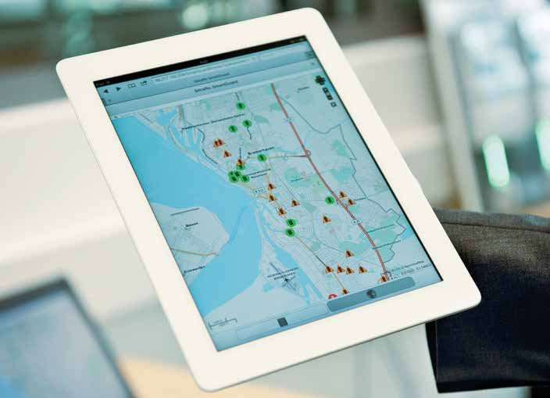
Sitraffic smartTL Connect
The era of Digitalization in Mobility 3
Our Vision 5
Concept 6
The Solution 7
Contact Information 8
Place Holder for picture

Slide 3

Sitraffic smartTL Connect The Era of Digitalization in Mobility
Now more than ever it is time to tailor both technology and our solutions to deliver the best product and fit our costumer’s needs and expectations.
With this in mind we developed a concept that unlocks new options on the services we provide along with our monitoring software Sitraffic smartGuard.
Its time to move into a new Era.

Slide 4
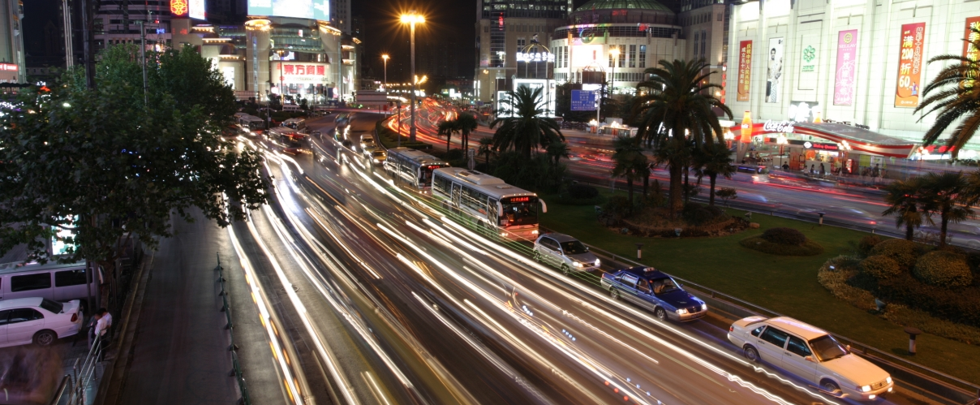
Sitraffic smartTL Connect

Slide 5

Sitraffic smartTL Connect Our Vision
Development of an independent, adaptable and unobtrusive solution that aims to integrate 3rd party controllers into smartGuard without the need for any changes to the hardware already in place.
Support to surveying processes, providing visibility on the operational performance of the installed base.
Focus on simplicity and flexibility.
Cost effective investment to minimize the challenge of
transitioning from different and previously incompatible systems.

Slide 6
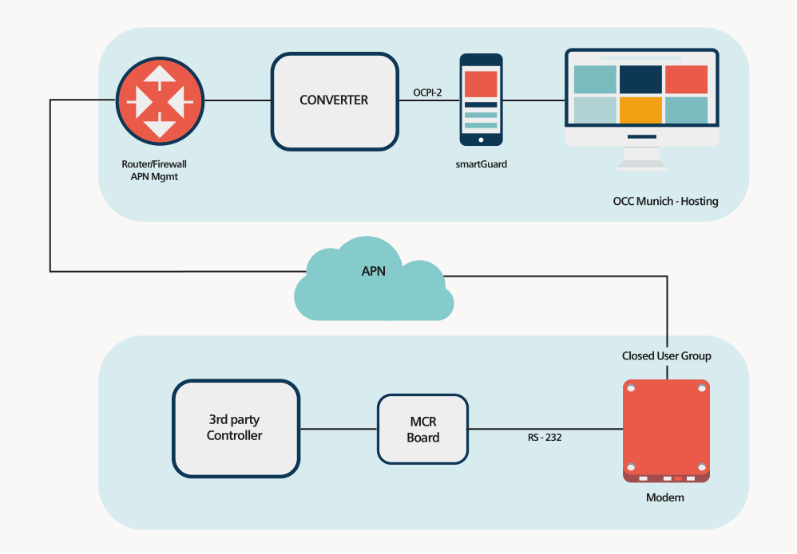
Sitraffic smartTL Connect Our Concept

Slide 7
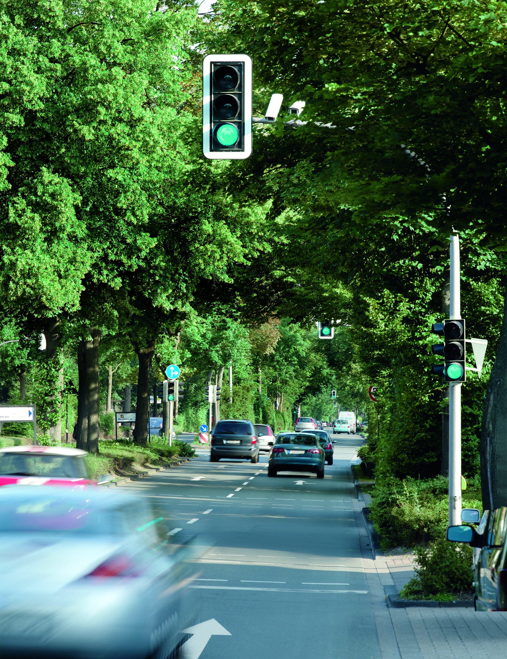
Sitraffic smartTL Connect The Solution
Our MCR board is wired directly into the cabinet connections and translates the electrical signals into messages to be sent by an APN network (IP) to the converter.
These messages will be stored in the converter server, a costume OCPI-2 server java application, and organized using an already existing protocol. The converter is built to communicate with smartGuard using OCPI data types already known to the software.

Slide 8
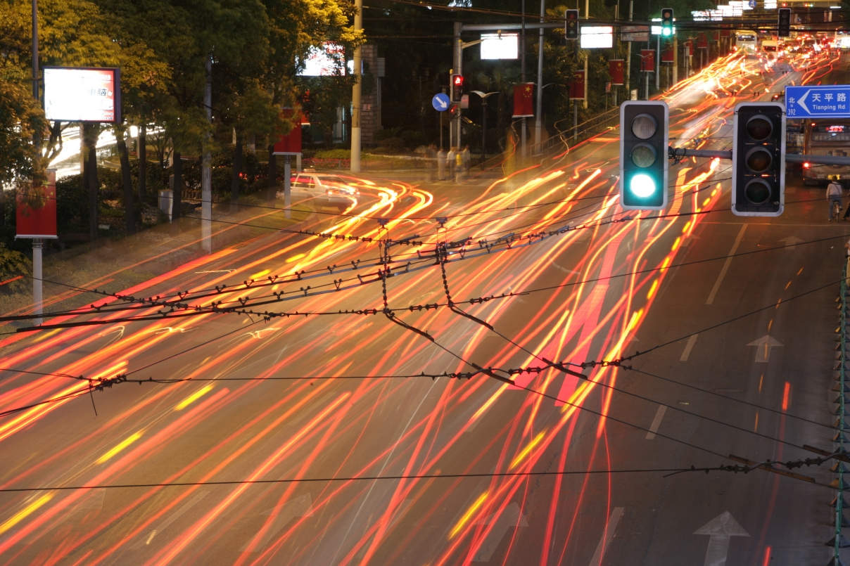
Sitraffic smartTL Connect Contact page
John Doe Job title Group / Region / Department XY
Street 123 12345 City
Phone: +49 123 45 67 89 Fax: +49 123 45 67 89 Mobile: +49 123 45 67 89 0
E-mail: john.doe@siemens.com
siemens.com

